Slide 1
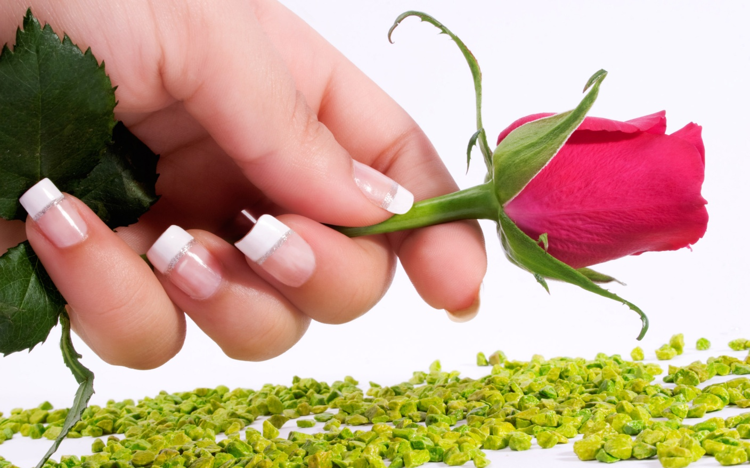
GOOD MORNING

Slide 2

Introduction:-
Md. Monir Hossain
Head Master
Jagannathpur Govt. Primary School.
Bancharampur; Brahmon Baria.

Slide 3

              Class- - Four.
                Subject –English.
                Lesson unit:-25
Headline:-A Day in a Garment Worker’s Life.
Lesson part:-I’m Reshma.--------------at Kalyanpur.

Slide 4

Learning outcomes:-
Students will able :- [1] To read this passage with appropriate pronunciation. [2] To say words, sentences and Wh questions

Slide 5


Warm up
Video Clip

Slide 6

Showing pictures Input
What are they doing ?

Slide 7
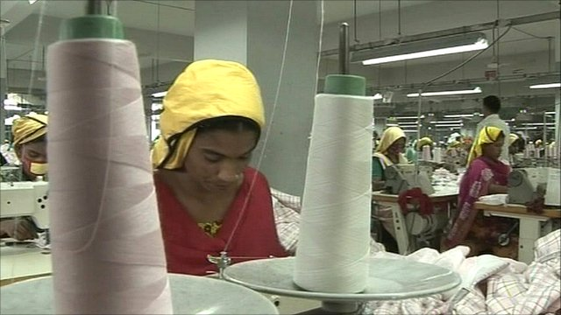
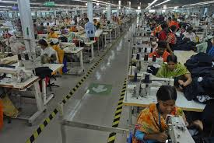

Garment’s worker

Slide 8
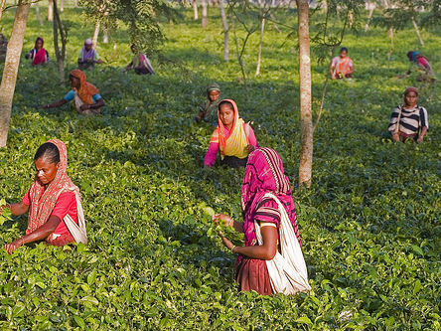

Tea garden in worker

Slide 9
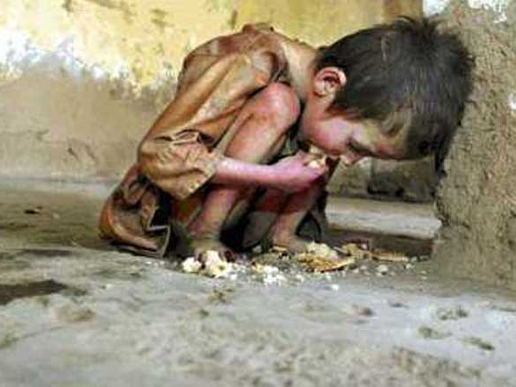
What’s this
Famine

Slide 10
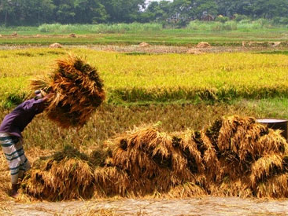
What’s this
Crops

Slide 11
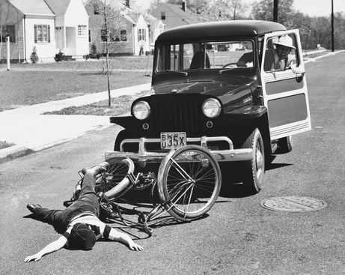
What’s this
Accident

Slide 12
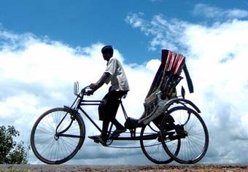
Who is he
Rickshaw puller

Slide 13
Input
Loud read:-
I’m Reshma. I’m a garment worker in Dhaka.I’m eighteen years old.Eight years ago my family came to Dhaka from Kurigram.Iwas in class five then. There was a famine in Kurigram that year.There were no crops, no food and no work in north.---------------small house at Kalyanpur.

Slide 14

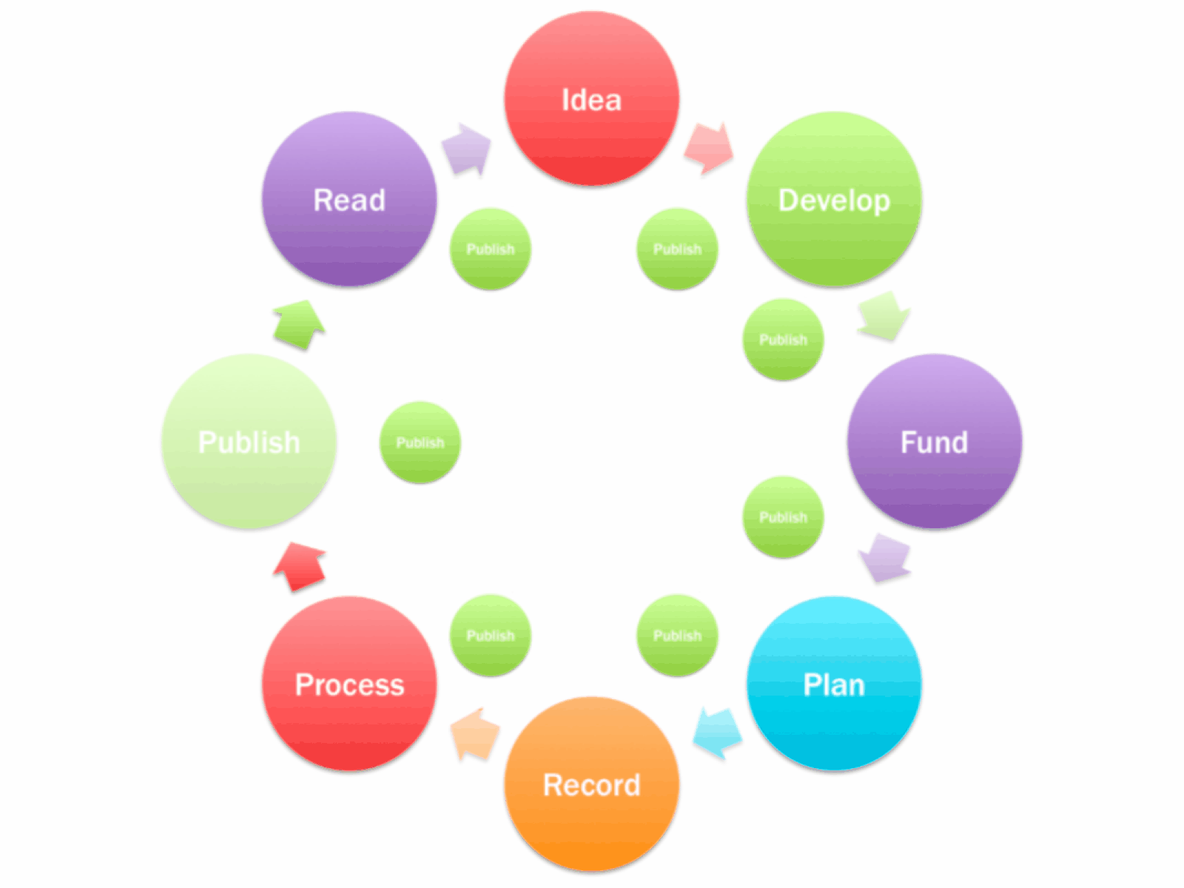
Practice
Students silent read.

Slide 15

New words:-
garment worker,famine, crops,accident, helpless

Slide 16
. MAKING SENTENCES:-
Worker:-Reshma is a garment worker.
Stiches:-She stiches nakshi katha at home.
Rickshaw puller:-Her father is a rickshaw puller.
Famine:-There was a famine in Kurigram that year.
Crops:- Rice , wheat are our main crops.
Single act

Slide 17

Fill in the blanks and match with left collumn:-
(a).-------old is Reshma?
(b)------does Reshma do?
(c).-------helped Reshma in Dhaka ?
(a).Her uncle Ratan helped.
(b).Reshma is 18.
(c).She works in a garment factory.

Slide 18
Group work: Practice
Make dialoque between a reporter and a garment worker.
Reporter: What’s----------------------?
Garment worker :----------------------Toma.
Reporter: How old---------------?
Garment worker:-------------Fifteen.

Slide 19

Task
Home work:-Write a short paragraph about a rickshaw puller.

Slide 20

Bye

